Slide 1



Enterprise Energy Data Platform (EEDP)
ABC Energy Ltd.
CURRENT PHASE
COURSE
Sprint 0 & Sprint 1
Data Engineering
TEAM MEMBERS
FACULTY
26MML1003 – Jaikrishna 26MML1014 - Sai Skanda U 26MML1027 – Perseus Mistry
Dr. M. Renukadevi

Slide 2


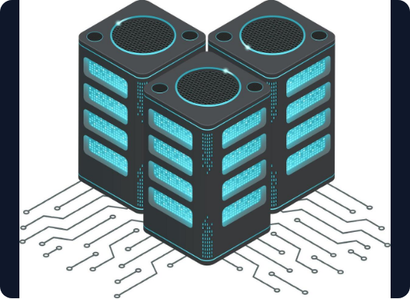
PROJECT OVERVIEW
EEDP is a Data Engineering platform for ABC Energy Ltd., serving more than 10 million consumers.
The project addresses the problem of fragmented enterprise energy data across multiple systems by providing a unified process for:
Data Ingestion [Current Phase: Done]
Data Cleaning & Validation
Data Integration
Data Storage
Analytics & Reporting
Note: Sprints 0 & 1 focus on foundational elements. Later sprints will extend to a complete data warehouse.

Slide 3




BUSINESS PROBLEM & NEED
The Problem
The Need
ABC Energy generates large volumes of data distributed across heterogeneous, independent sources.
ABC Energy requires a centralized Data Engineering platform capable of integrating, validating, and preparing enterprise data for reliable analytics and decision-making.
Data exists in different formats and structures.
No unified view of enterprise information.
Data contains missing, invalid, or duplicate records.
Difficult to integrate information from diverse systems.
Manual preparation increases effort and reduces consistency.

Slide 4
BUSINESS REQUIREMENTS
To solve the fragmented data challenge, the EEDP must deliver on the following core requirements:
Integrate Sources: Bring relevant enterprise data sources into a common platform.
Traceability: Provide complete traceability across the data pipeline.
Standardize: Provide standardized and validated data for downstream applications.
Centralized Storage: Provide reliable storage for processed enterprise data.
Define Fields: Maintain clear definitions and meanings for important data fields.
Enable Reporting: Support reliable reporting and analytics dashboards.
Map Lineage: Maintain source-to-target mappings for data integration.
Future-Proof: Establish a foundation for future energy-data use cases.

Slide 5












PROJECT OBJECTIVES
Identify & Profile
Clean & Standardize
ETL Pipelines
Identify relevant enterprise sources, understand structures, and perform deep data profiling and quality analysis.
Thoroughly clean, validate, and standardize incoming enterprise data to resolve inconsistencies.
Develop repeatable, robust ETL pipelines using Pentaho Data Integration for automated workflows.
Central Storage
Documentation
Analytics Foundation
Store processed data efficiently using PostgreSQL to act as the central staging and data warehouse.
Develop a data dictionary, define source-to-staging mappings, and maintain version control via Git.
Establish a solid, reliable foundation for future Power BI analytics and energy reporting use cases.

Slide 6

PROJECT SCOPE
Area | Scope / Activity | Tool / Tech
Requirement Analysis | Business requirement documentation | Markdown / MS Word
Data Discovery | Identification & analysis of enterprise sources | Python / Excel
Data Dictionary | Documentation of source fields and attributes | Excel / Markdown
Data Ingestion | Extraction and loading of heterogeneous data | Pentaho Data Integration
Data Profiling | Analysis of data structure and quality | Python / Pandas
Data Cleaning | Data cleansing and validation rules implementation | Python / Pandas, Pentaho
Data Storage | Staging and centralized data warehouse setup | PostgreSQL
Data Lineage | Source-to-target mapping & lineage docs | Markdown
ETL Orchestration | Automated ETL workflow development | Pentaho Data Integration
Version Control | Source-code and project collaboration management | Git / GitHub

Slide 7

ENTERPRISE DATA SOURCES
Dataset Name | Type | Primary Domain | Key Variables (Subset)
asset_maintenance.csv | CSV | Predictive Maintenance | Temp, Rotational Speed, Torque, Wear, Failure Type
Billing_payments.csv | CSV | Utility Financials | Peak Demand, Generation, Sector Revenues
CIS.xml | XML | Customer Info System | Root, Result, Child Data, Unique Attributes
iiot_smart_grid_dataset.csv | CSV | Smart Grid Telemetry | Voltage, Current, Power Factor, Renewable Gen
OMS_data.csv | CSV | Outage Management | Event Times, NERC Region, Demand Loss, Affected
owid-energy-data.json | JSON | Global Energy Trends | Generation & Shares (Biofuel, Coal, Gas, Solar, Wind)
scada_pipeline.csv | CSV | SCADA Pipeline | Pressure, Flow Rate, Valve State, Alarms
smart_meter_data.csv | CSV | Smart Meter Consump. | Electricity Consumed, Weather Metrics, Anomaly

Slide 8









TECHNOLOGY STACK
Data Integration & Storage
Analysis & Processing
Pentaho (Spoon): ETL development & orchestration. PostgreSQL: Staging and centralized data storage.
Python: Data analysis and advanced profiling. Pandas: Data manipulation and quality analysis.
Version Control & Mgmt
Analytics & Documentation
Git/GitHub: Version control & team collaboration. Scrum: Sprint and backlog management.
Power BI: Analytics and visualization dashboarding. Markdown/Word: Technical project documentation.

Slide 9
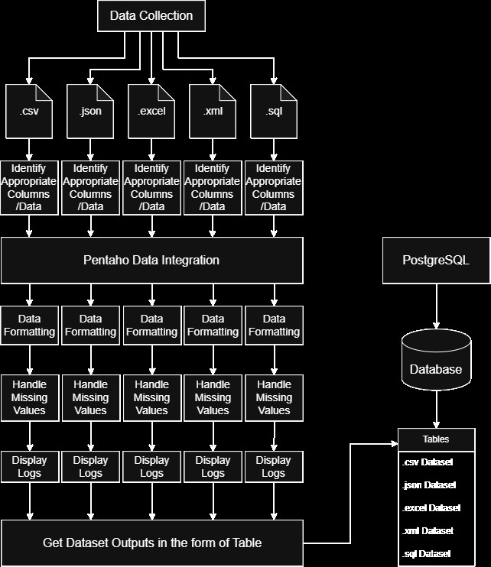
INITIAL ARCHITECTURE
Sprint 0 & Sprint 1 Deliverables
The current architecture focuses on establishing the foundational data pipelines, collecting diverse file formats, and loading them into a structured database.
Data Collection: Ingestion of CSV, JSON, Excel, XML, and SQL formats.
Column Mapping: Identifying appropriate columns and schemas for staging.
Pentaho Processing: Applying formatting rules and handling missing values systematically.
Logging & Error Handling: Displaying logs and capturing pipeline metrics.
PostgreSQL DB: Storing output tables in a centralized relational database.
* Architecture is subject to change in subsequent sprints as the warehouse evolves.

Slide 10


CHALLENGES & SOLUTIONS
Challenge: Heterogeneous Source Formats
Challenge: Data Quality Inconsistencies
Solution
Solution
Implemented rigorous data profiling and dynamic standardization processes to unify file structures.
Developed strict validation and automated cleaning rules within Python and Pentaho pipelines.
Challenge: Multiple Enterprise Systems
Challenge: Difficulty Tracing Source Fields
Solution
Solution
Designed a centralized integration architecture (PostgreSQL Data Warehouse) as a single source of truth.
Established a comprehensive Data Dictionary and detailed source-to-target mapping documentation.

Slide 11









TEAM CONTRIBUTIONS
Perseus Mistry
Sai Skanda U
Jaikrishna
26MML1027
26MML1014
26MML1003
Handling Documentation
Finding Datasets
Finding Datasets
GitHub Repository Mgmt
Pentaho Transformations
Pentaho Transformations
Pentaho Transformation Debugging/Supervising
Mapping Data Sources (Documentation)
Pentaho Jobs Integration

Slide 12


Thank You
Enterprise Energy Data Platform (EEDP)
We are open to any questions.
Jaikrishna
Sai Skanda U
Perseus Mistry
26MML1003
26MML1014
26MML1027

